Slide 1
Interpersonal Savvy
Samson Yosef
Reagan prince

Slide 2
What is Interpersonal Savvy?
Interaction with others appropriately
Getting along with others whilst still reaching the objective
Essential when working in an organisation

Slide 3
Attributes
Relates to all kinds of people
Uses diplomacy and tact
Interpersonal Savvy
Builds appropriate rapport
Can diffuse even high-tension situations comfortably
Builds constructive and effective relationships

Slide 4
Scenario…
Whilst working on a project, there is a disagreement in your team of five, where two co-workers have a dispute over what approach to go for. They are both convinced that their own idea is the right one.
How would you react?

Slide 5
Effective | Ineffective
Try and see both approaches respectively and find a way where both parties are satisfied. | Try to side with one approach and provide facts to why it is the correct approach.
Take a proactive role, try to diffuse the situation and initiate a constructive discussion. | Ignore the conflict and hope that the situation is resolved on its own.
Try and involve the other two co-workers and invite their own perspectives to move the discussions forward. | Ignore the other two co-workers and focus only on resolving this dispute.
Action 1
Action 2
Action 3

Slide 6
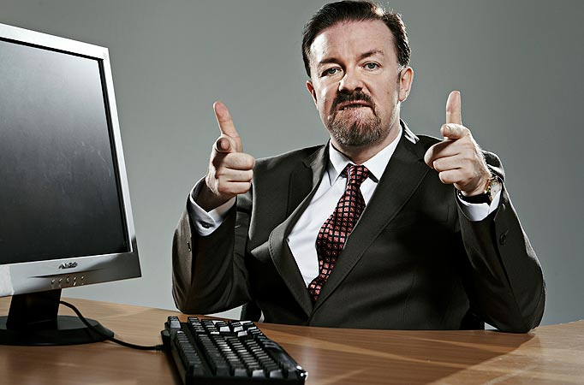

Personal Experience

Slide 7
Thank you!

